Slide 1
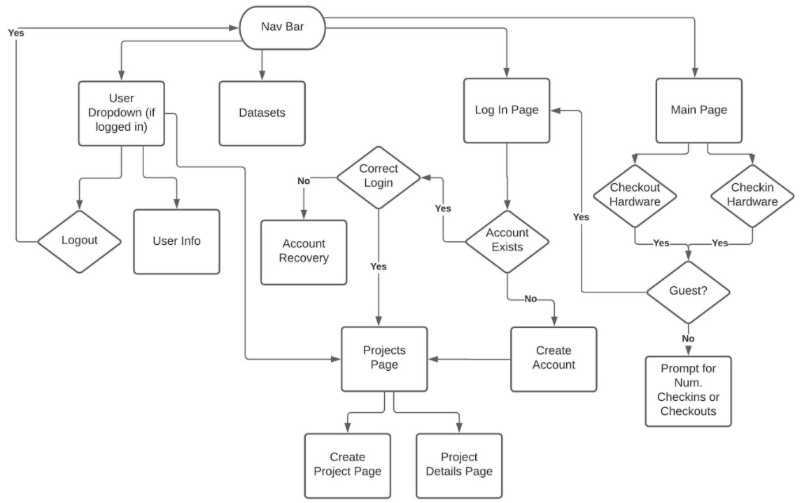
This userflow is not 100% the same as the
Slides followed, but Is almost the same. More
discussion is encouraged.

Slide 2
14 pages:
(bolded are the ones connected to the backend):
Rachel : Home, hardware_checkin_page, hardware_checkin_success_page ,
hardware_checkout_page, hardware_checkout_success_page ,
Sohaib, Yue: login, create_account,
Lian: user_projects_page, create_project_page, user_open_project_page,
Mona & Yue: Data_set_page, download_dataset_page, Edit_user_profile_page
--------------------------------
Function component
Connect to physioNet, download as zip

Slide 3
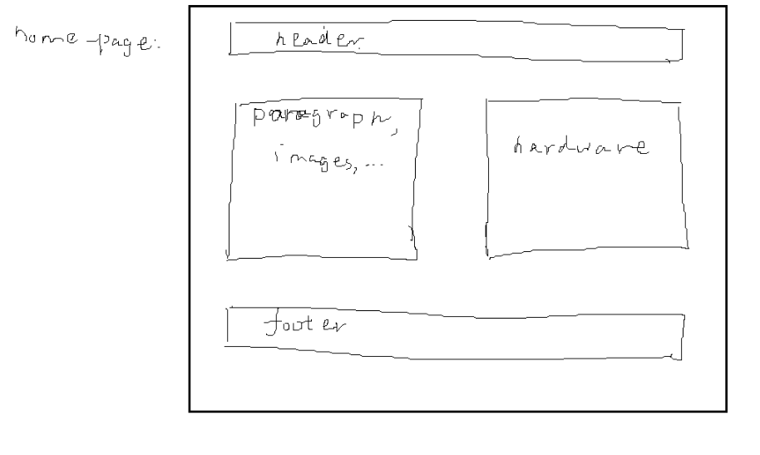
homepage

Slide 4
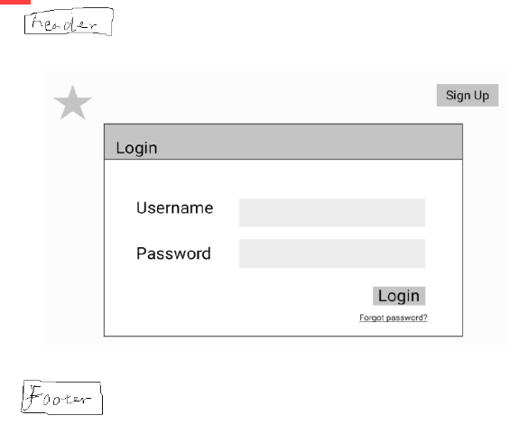
Login_page

Slide 5
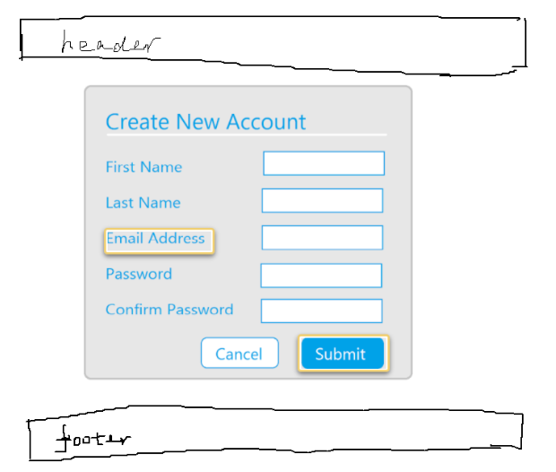
create_account_page
username

Slide 6
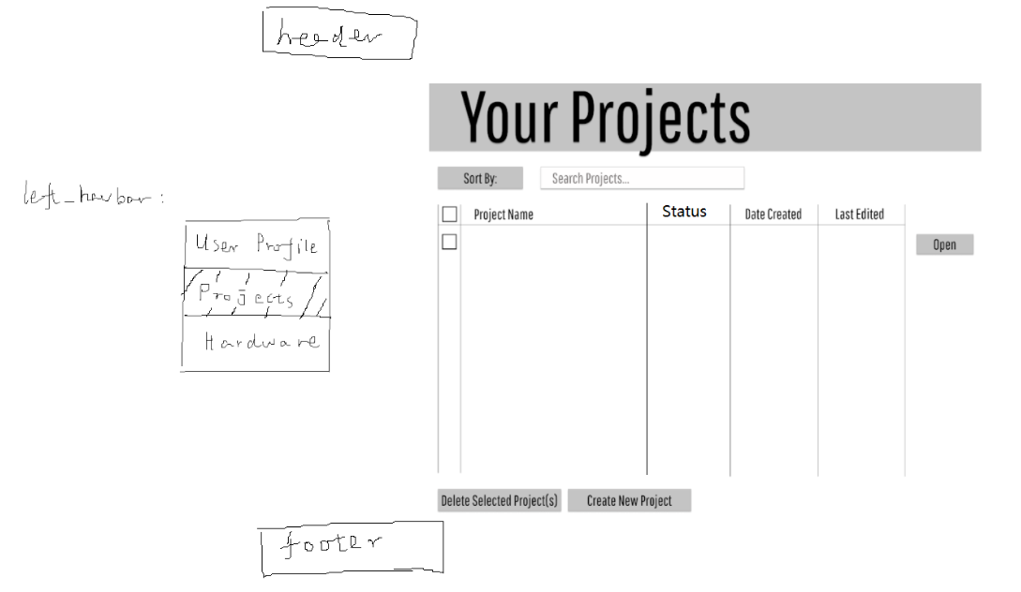
User_projects_page

Slide 7
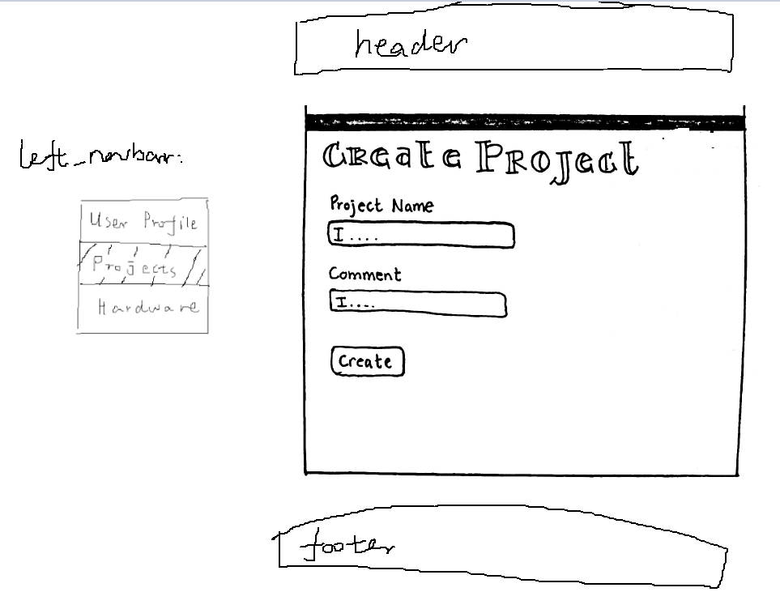
create_project_page

Slide 8
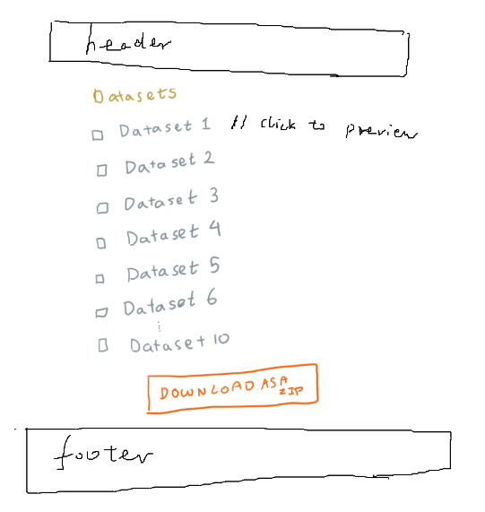
dataset_page

Slide 9
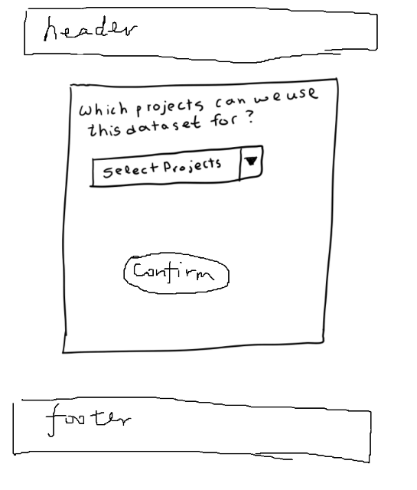
download_dataset_page

Slide 10
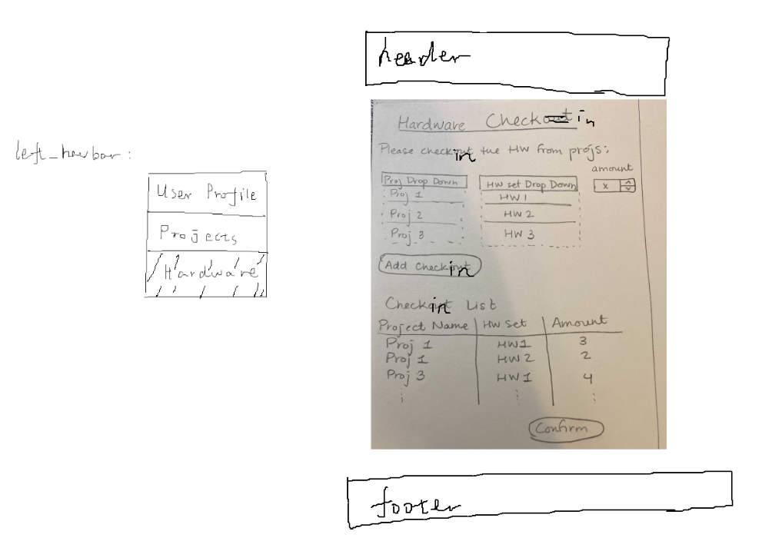
hardware_checkin_page

Slide 11
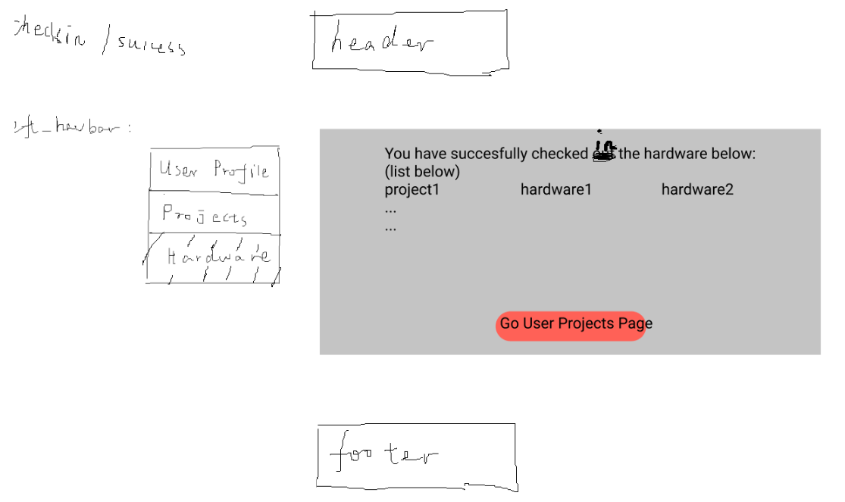
hardware_checkin_success_page

Slide 12
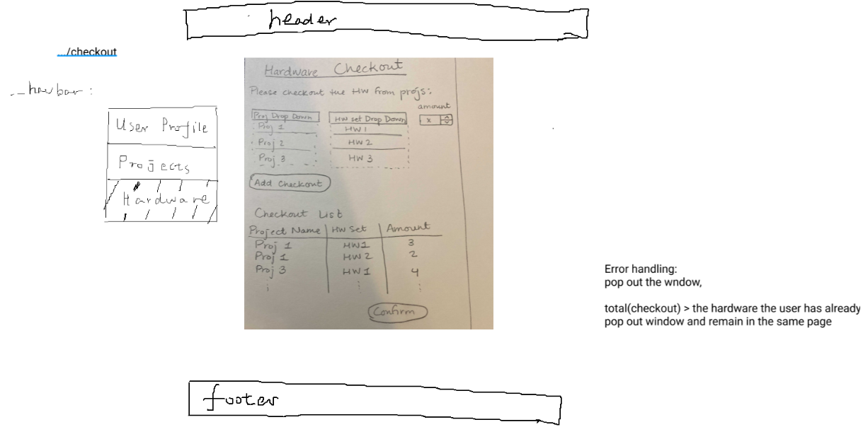
hardware_checkout_page

Slide 13
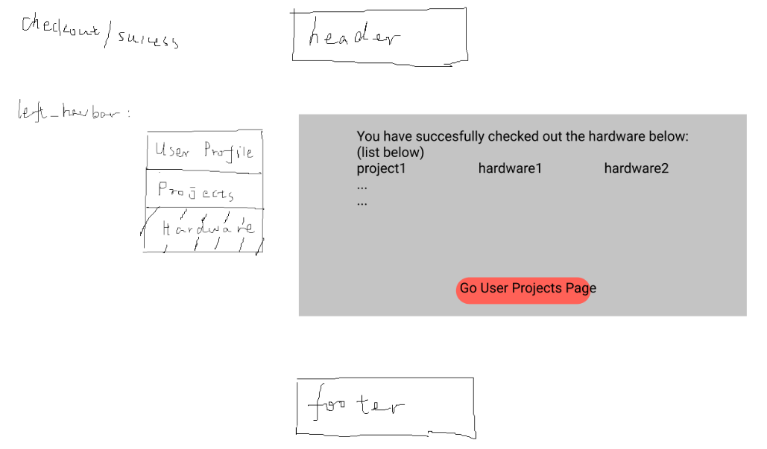
hardware_checkout_success_page

Slide 14
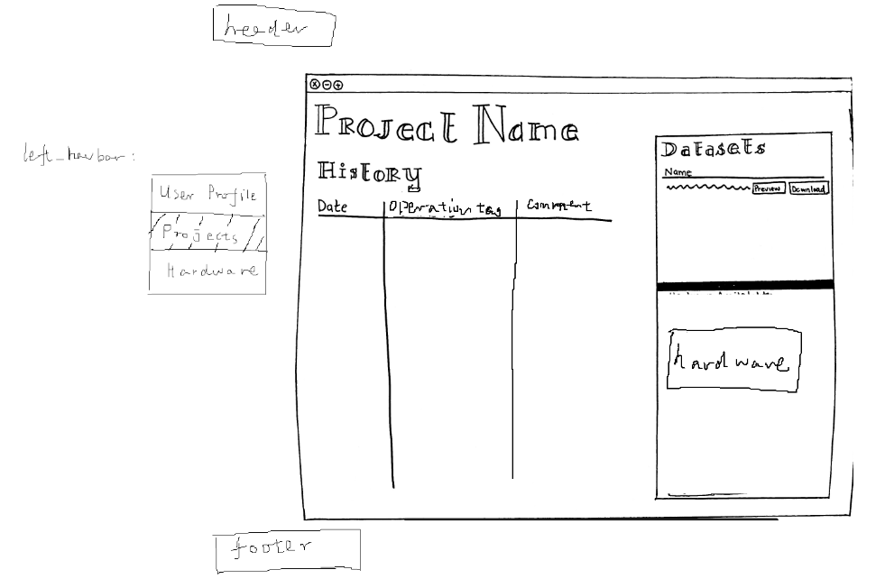
user_open_project_page

Slide 15
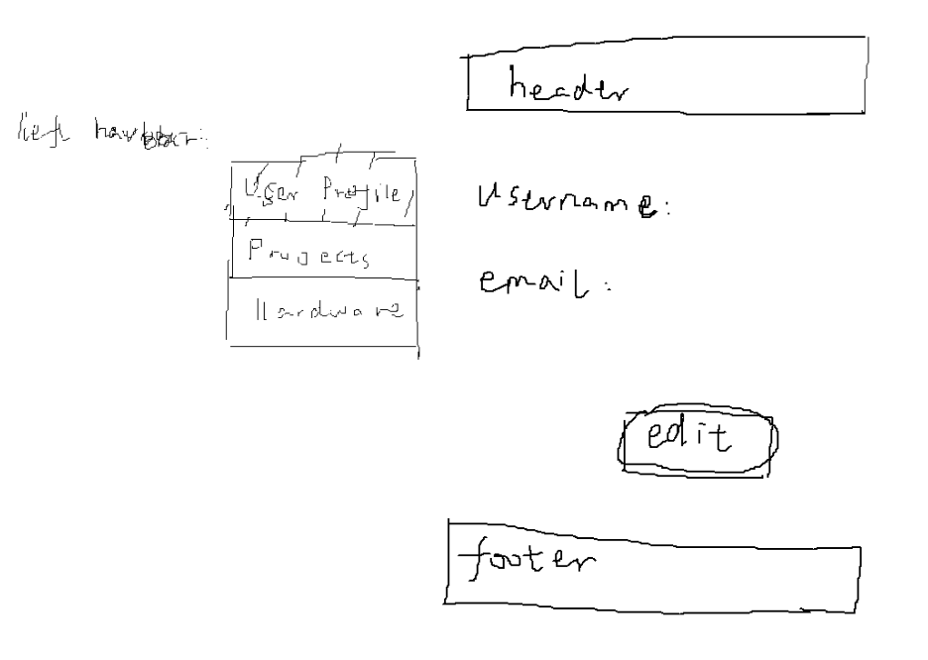
Edt_user_profile_page

Slide 16
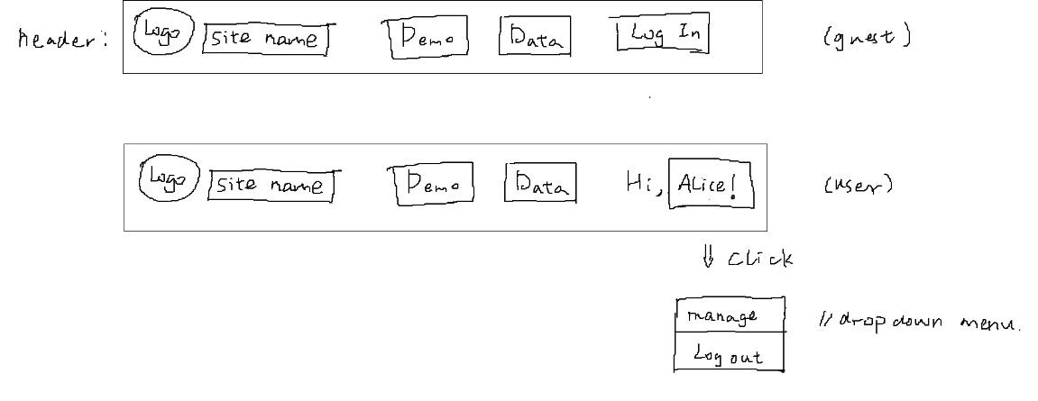
Header component:

Slide 17

footer component:

Slide 18
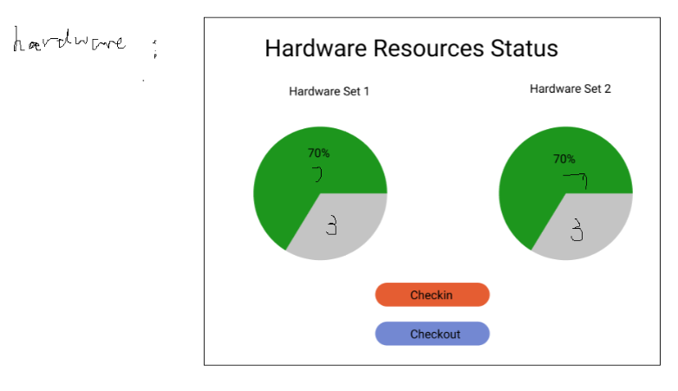
hardware component:

Slide 19
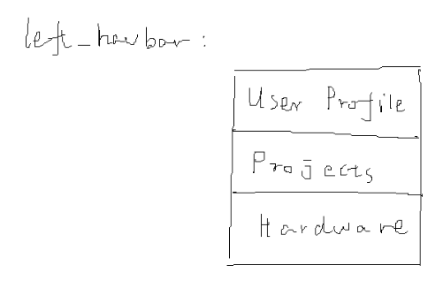
Left_navbar component:

Slide 20
forget_pw_page:
Not implemented yet

Slide 21
Edit_user_profile_page:
Not implemented yet

Slide 22
Page to have our bibliography

Slide 23
Demo_page:
We can make a video of our web application demo, uploaded it to youtube, and use API to display it on this page.
Put header and footer as usual.

